Slide 1
The Simpsons
İlker Kendir

Slide 2
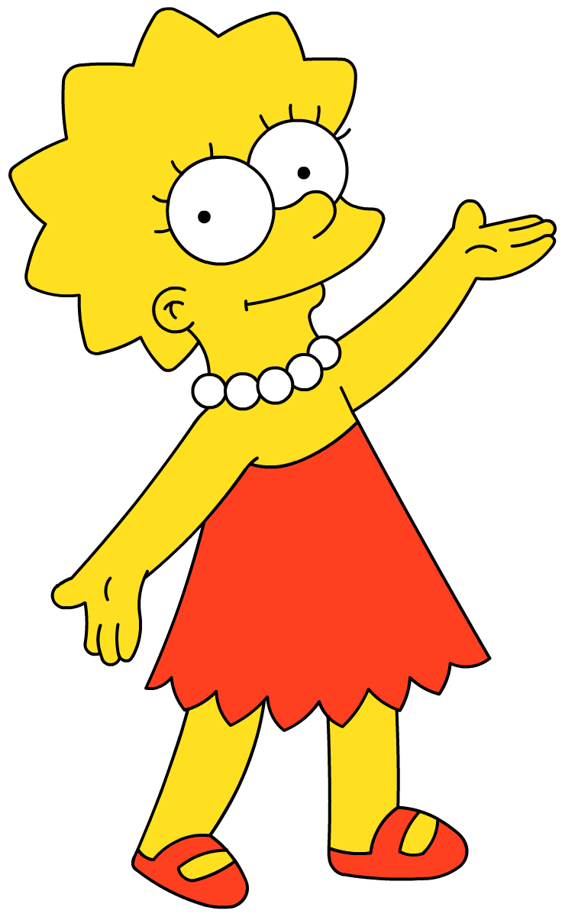
Hi, my name is Lisa Simpson.
This is my family

Slide 3
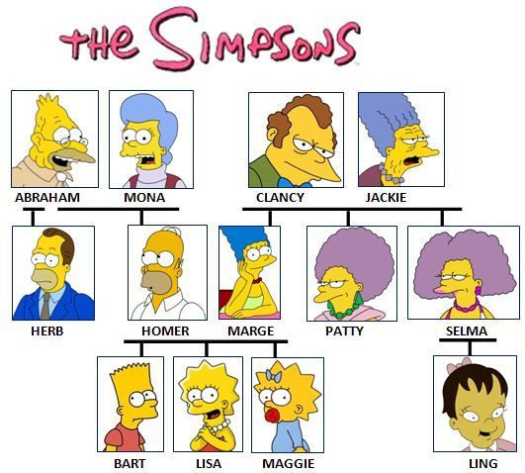

Slide 4
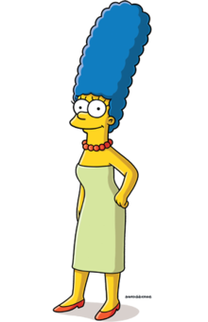
This is my mother. Her name is Marge.
mum
mummy

Slide 5
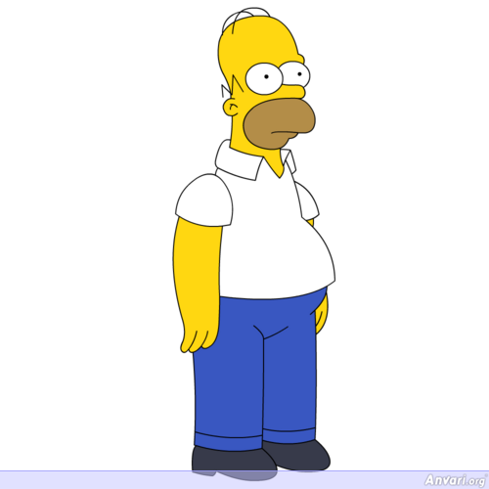
This is my father. His name is Homer.
dad
daddy
papa

Slide 6
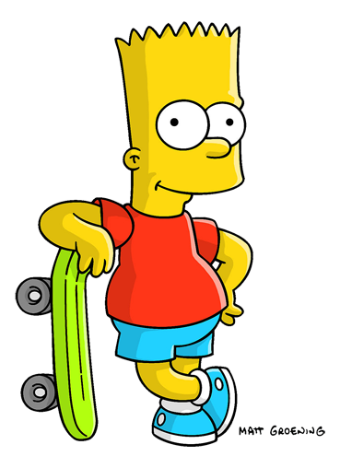
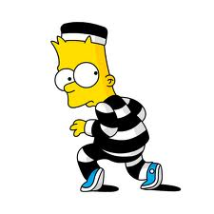
This is my brother. His name is Bart.

Slide 7
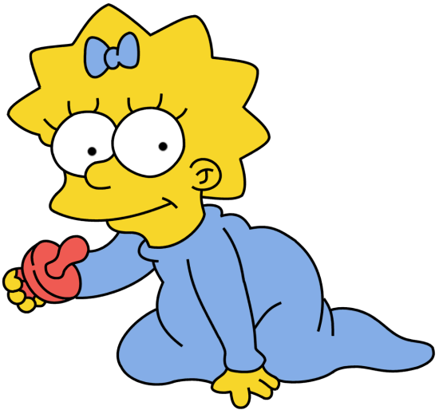
This is my sister. Her name is Maggie.

Slide 8
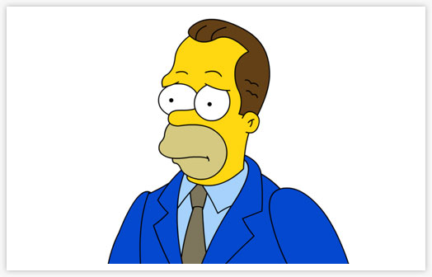
This is my uncle. His name is Herb.

Slide 9
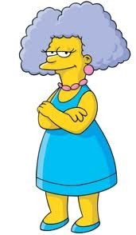
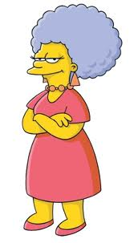
These are my aunts. Their names are Selma and Patty.

Slide 10
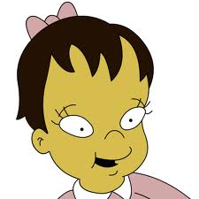
This is my cousin. Her name is Ling.

Slide 11
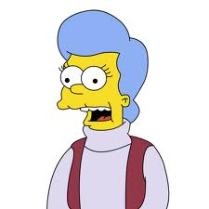
This is my grandmother. Her name is Mona.
grandma

Slide 12
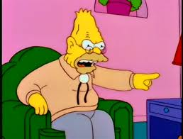
This is my grandfather. His name is Abraham.
grandpa

Slide 13
Who are they?

Slide 14
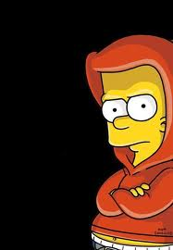
This is my................... His name is Bart.
brother

Slide 15
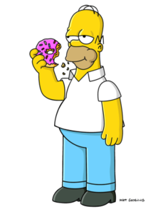
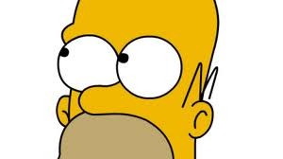
This is my................... His name is Homer.
father

Slide 16
This is my................... Her name is Maggie.
sister

Slide 17
This is my................... Her name is Ling.
cousin

Slide 18
This is my................... Her name is Selma.
aunt

Slide 19
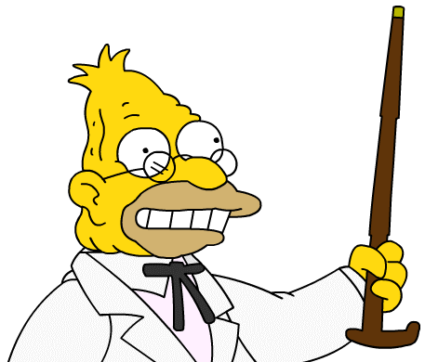
This is my................... His name is Abraham.
grandfather

Slide 20
This is my................... Her name is Marge.
mother

Slide 21
This is my................... His name is Herb.
uncle

Slide 22
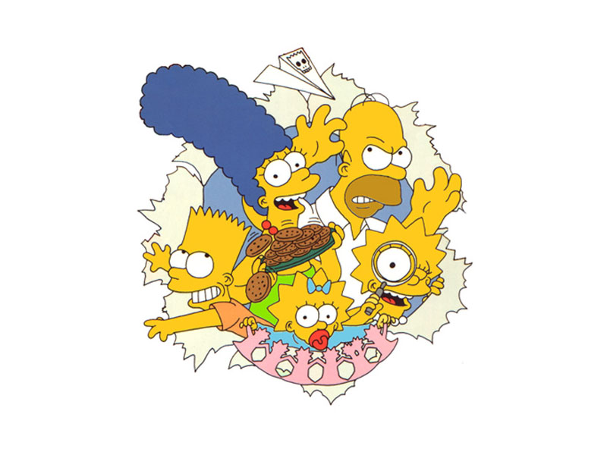
This is my family

Slide 23
That’s all folks

