Slide 1
Unit 10
Animals (2)

Slide 2
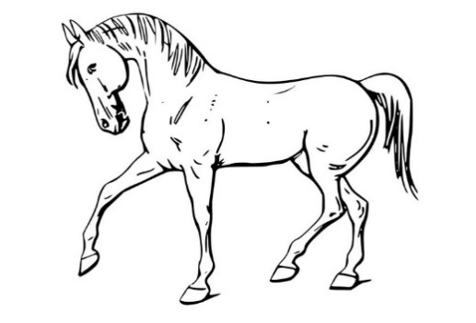
Can horses swim?
Yes, they can.

Slide 3
Can lions swim?
No, they can’t.

Slide 4
Can dogs run?
Yes, they can.

Slide 5
Can snakes run?
No, they can’t.

Slide 6
Dogs can run but snakes can’t run.

Slide 7
Horses can swim but lions can’t swim.

