Slide 1
Unit 9
Fruit ( 1 )

Slide 2
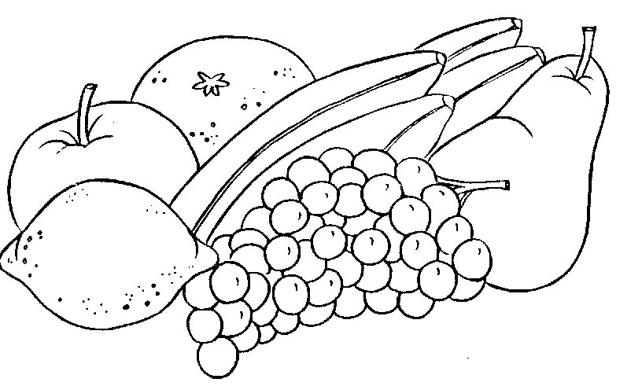
fruit
meyve

Slide 3
apple
elma

Slide 4
banana
muz

Slide 5
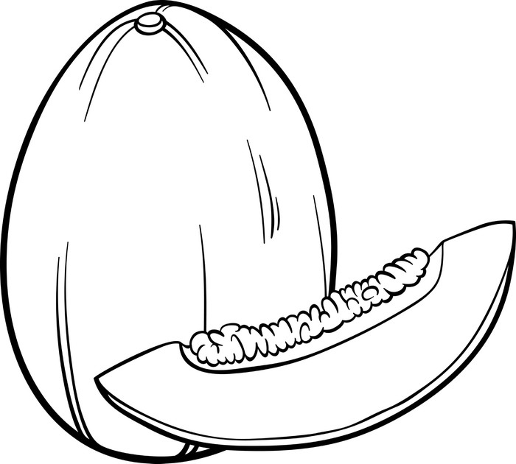
melon
kavun

Slide 6
watermelon
karpuz

Slide 7
strawberry
çilek

Slide 8
cherry
kiraz

Slide 9
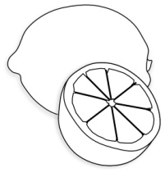
lemon
limon

Slide 10
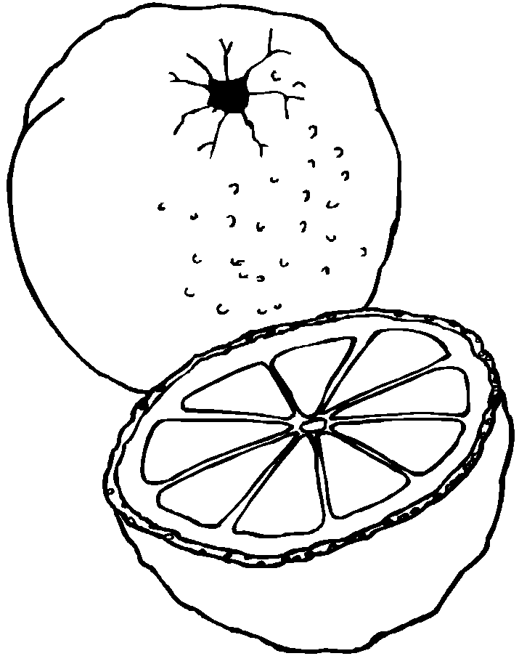
orange
portakal

Slide 11
grapes
üzüm

Slide 12
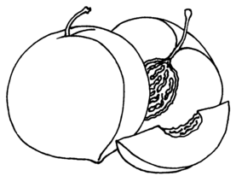
peach
şeftali

Slide 13
eat
yemek

Slide 14
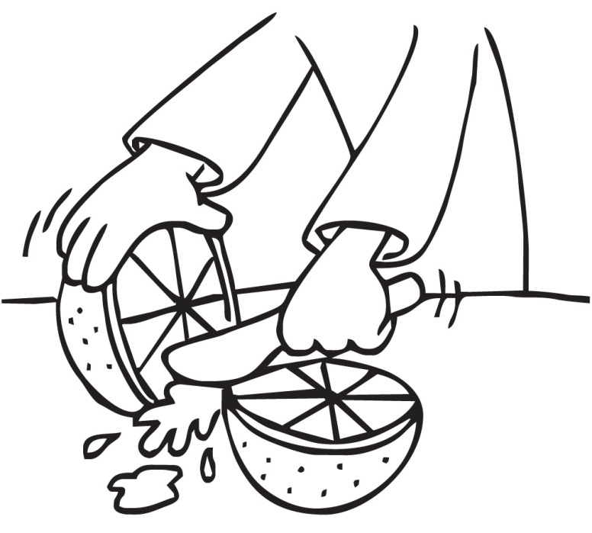
cut
kesmek

Slide 15
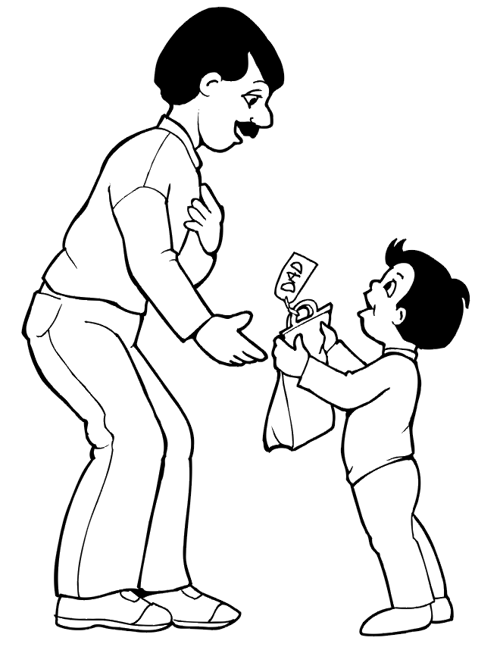
give
vermek

Slide 16
yummy
lezzetli

Slide 17
and
+ and +
ve

Slide 18
but
+ but -
fakat, ama

