Slide 1
Unit 9
Fruits ( 2 )

Slide 2
I like bananas.

Slide 3
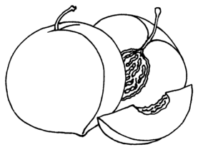
I don’t like peaches.

Slide 4
I like watermelons.

Slide 5
I don’t like grapes.

Slide 6
I like apples.

Slide 7
I don’t like lemons.

Slide 8
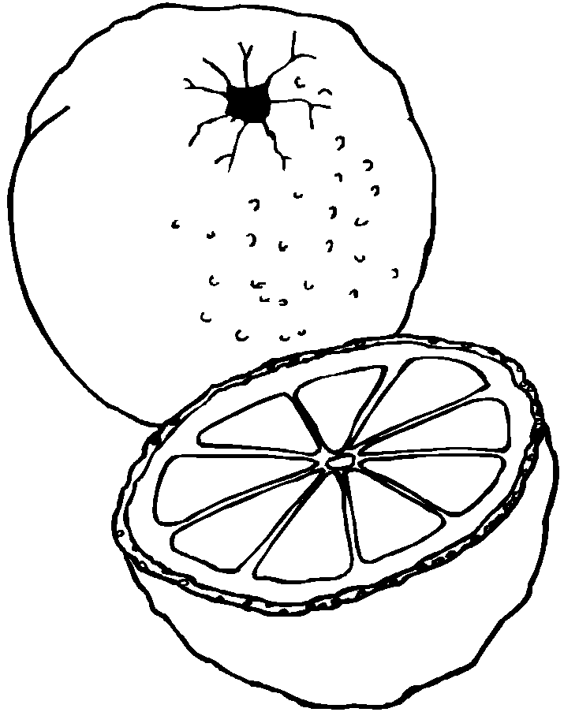
I like oranges.

Slide 9
I don’t like strawberries.

Slide 10
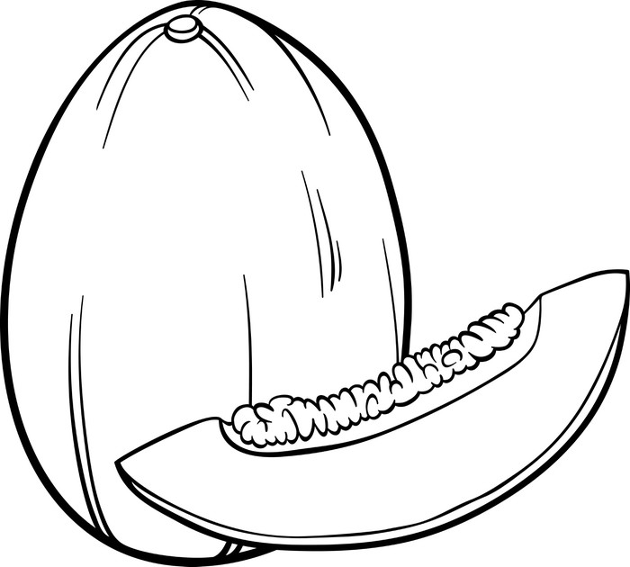
I like melons.

