Slide 1
Unit 9
Fruits ( 3 )

Slide 2
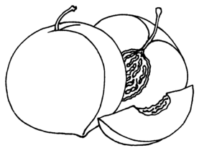
I like watermelons and peaches.

Slide 3
I like bananas but I don’t like apples.

Slide 4
I like lemons but I don’t like grapes.

Slide 5
I like melons and strawberries.

Slide 6
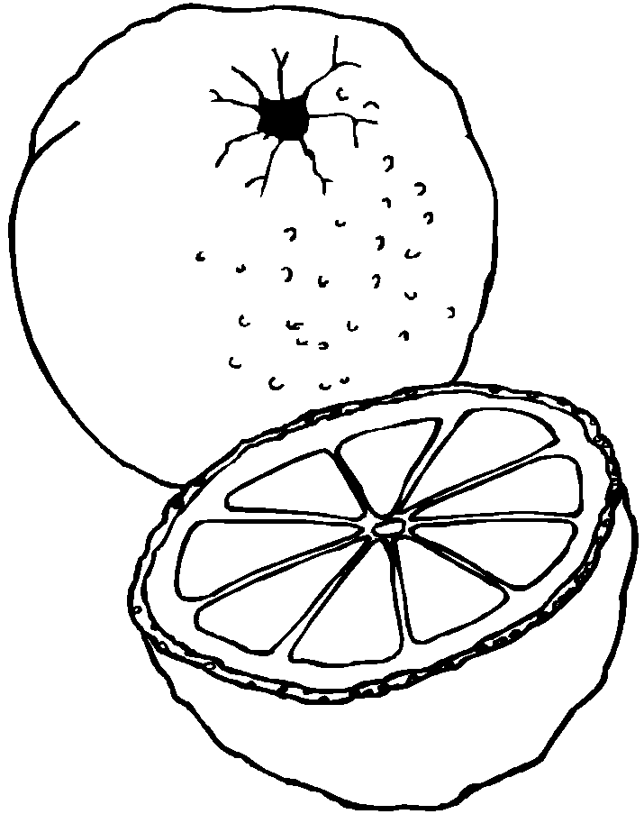
I like oranges but I don’t like melons.

Slide 7
I like grapes and peaches.

