Slide 1
HOBBİES AND İNTERESTS

Slide 2
WHAT DO YOU ENJOY DOİNG ?
BOWLİNG
CAMPİNG

Slide 3
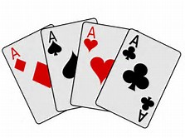
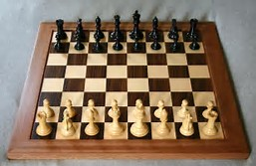
WHAT DO YOU ENJOY DOİNG ?
CARD GAMES
CHESS

Slide 4
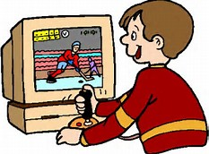
WHAT DO YOU ENJOY DOİNG ?
CİNEMA
COMPUTER GAMES

Slide 5
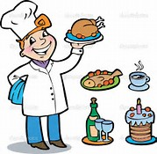
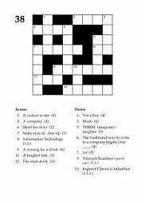
WHAT DO YOU ENJOY DOİNG ?
COOKİNG
CROSSWORDS

Slide 6
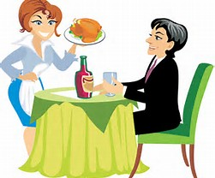
WHAT DO YOU ENJOY DOİNG ?
DARTS
EATİNG OUT

Slide 7
WHAT DO YOU ENJOY DOİNG ?
GARDENİNG
THE İNTERNET (THE NET)

Slide 8
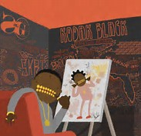
WHAT DO YOU ENJOY DOİNG ?
KNİTTİNG
Painting

Slide 9
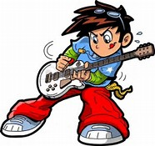
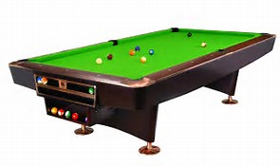
WHAT DO YOU ENJOY DOİNG ?
PLAYİNG GUİTAR
POOL

Slide 10
WHAT DO YOU ENJOY DOİNG ?
PUZZLE GAMES
READİNG

Slide 11
WHAT DO YOU ENJOY DOİNG ?
SAİLİNG
SUNBATHİNG

Slide 12
WHAT DO YOU ENJOY DOİNG ?
TRAVELLİNG
WATCHİNG TV

Slide 13
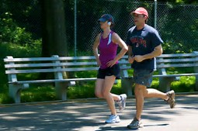
WHAT DO YOU ENJOY DOİNG ?
JOGGİNG
MUSİC

Slide 14
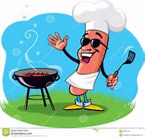
WHAT DO YOU ENJOY DOİNG ?
BARBECUE
BASKETBALL

