Slide 1


©
THIS IS NURCAN AKALTUN’S WORK
BU BİR NURCAN AKALTUN ÇALIŞMASIDIR.

Slide 2

windy

Slide 3

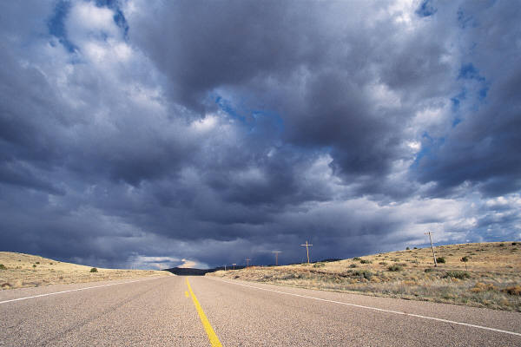
Cloudy
Bulutlu

Slide 4


sunny

Slide 5

snowy

Slide 6

rainy

Slide 7

Foggy=sisli

Slide 8
Stormy = fırtınalı

Slide 9
Warm = having a temperature between cool and hot
ılık, hafif sıcak

Slide 10
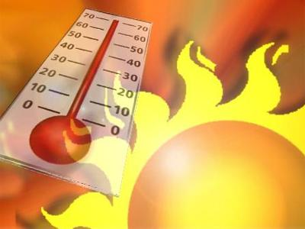

hot

Slide 11
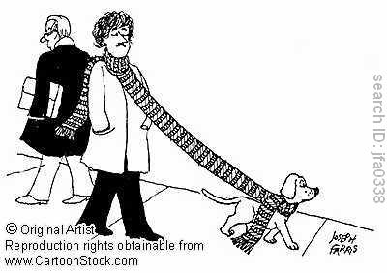
Cool = slightly cold, but not too cold
serin, soğuk

Slide 12
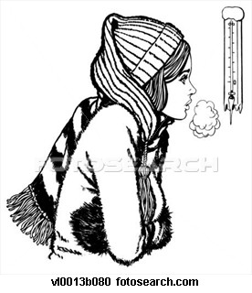
cold

Slide 13


Raindrop =a single drop of rain
yağmur damlası

Slide 14



Snowflake =a small piece of snow that falls from the sky
kar tanesi

Slide 15

It is--------- today.
cold
Windy
Hot

Slide 16
It is--------- today.
Sunny
Windy
rainy

Slide 17

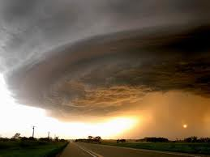
It is--------- today.
Stormy
Warm
cool

Slide 18
It is--------- today.
Snowy
Cloudy
foggy

Slide 19
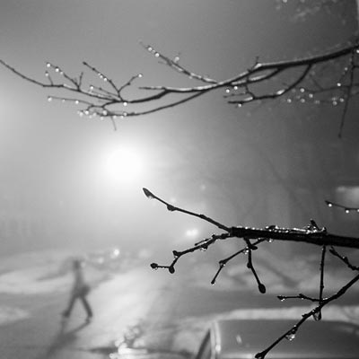
It is--------- today.
Snowy
Cloudy
foggy

Slide 20
It is--------- today.
Sunny
Windy
rainy

Slide 21

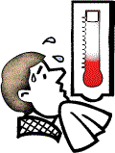
It is--------- today.
cold
Windy
Hot

Slide 22
It is--------- today.
cold
Windy
Hot

Slide 23
It is--------- today.
Stormy
Warm
cool

Slide 24
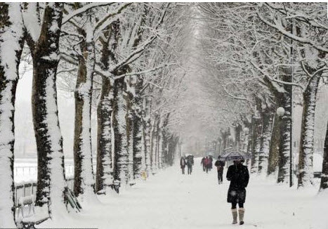

It is--------- today.
cold
Windy
Hot

Slide 25
It is--------- today.
Sunny
Windy
rainy

Slide 26


It is--------- today.
Snowy
Cloudy
foggy

Slide 27
It is--------- today.
Stormy
Warm
cool

Slide 28


It is--------- today.
Snowing
raining
shining

Slide 29

It is--------- today.
Snowing
raining
shining

Slide 30

It is--------- today.
Snowing
raining
shining

Slide 31

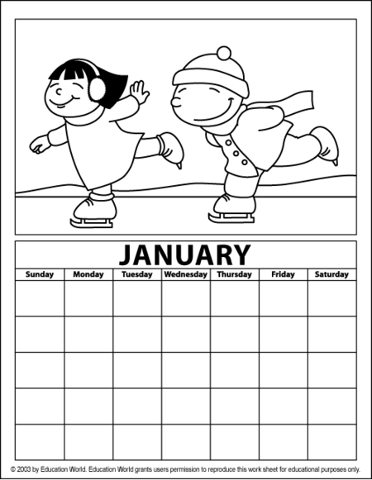
January =Ocak

Slide 32
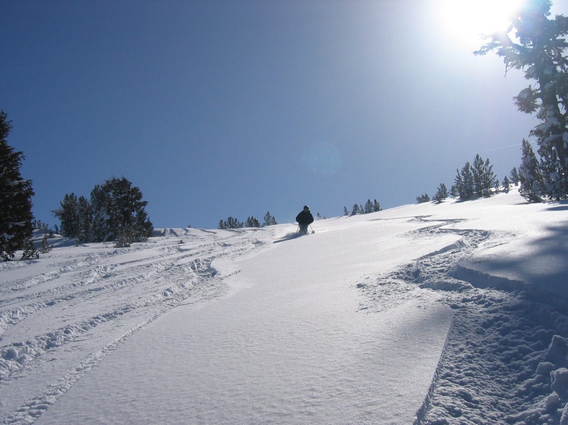
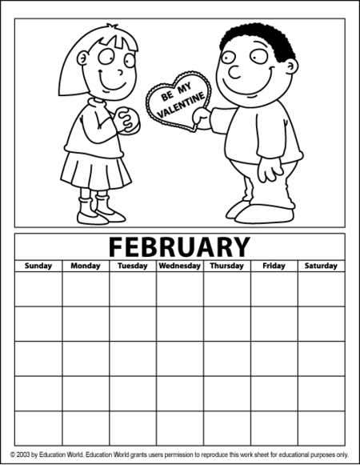
February=Şubat

Slide 33

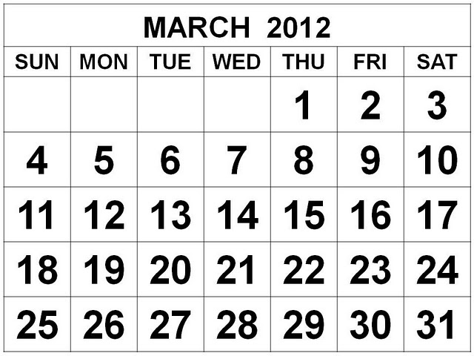
March =Mart

Slide 34
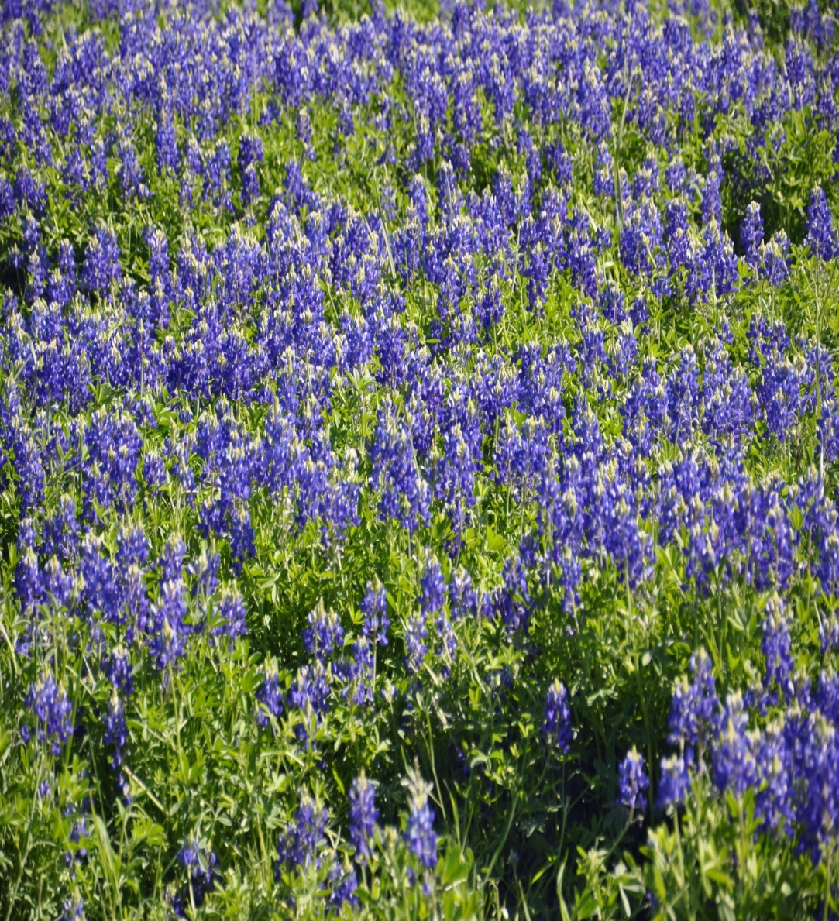
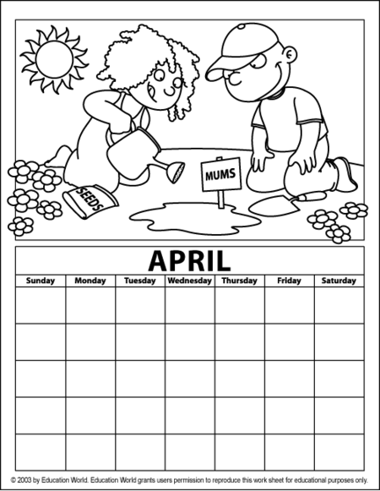
April=Nisan

Slide 35

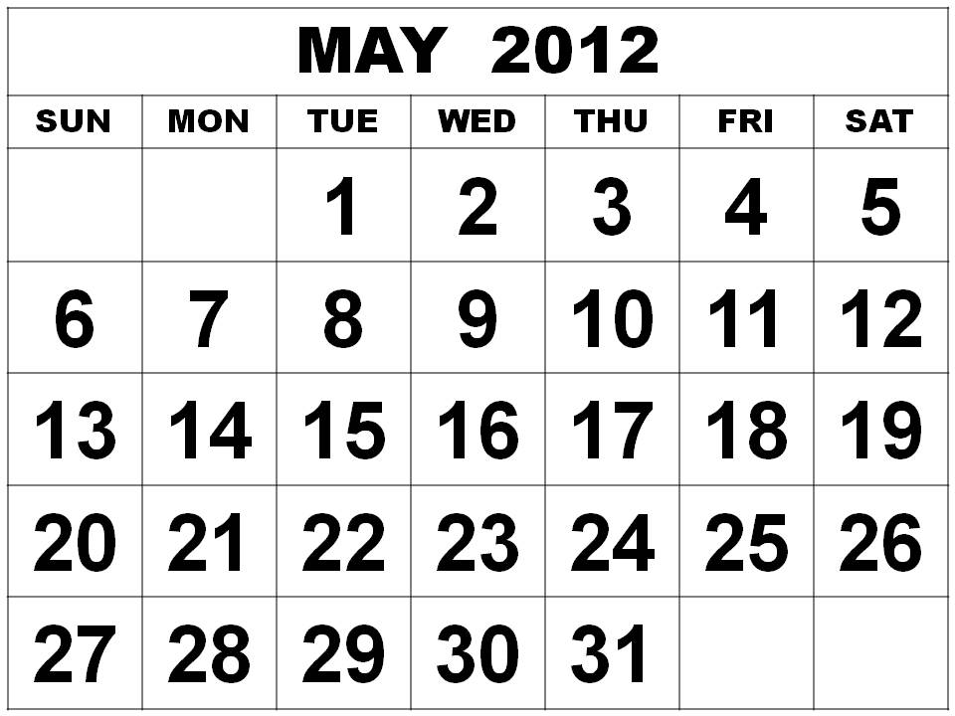
May =Mayıs

Slide 36

June = Haziran

Slide 37
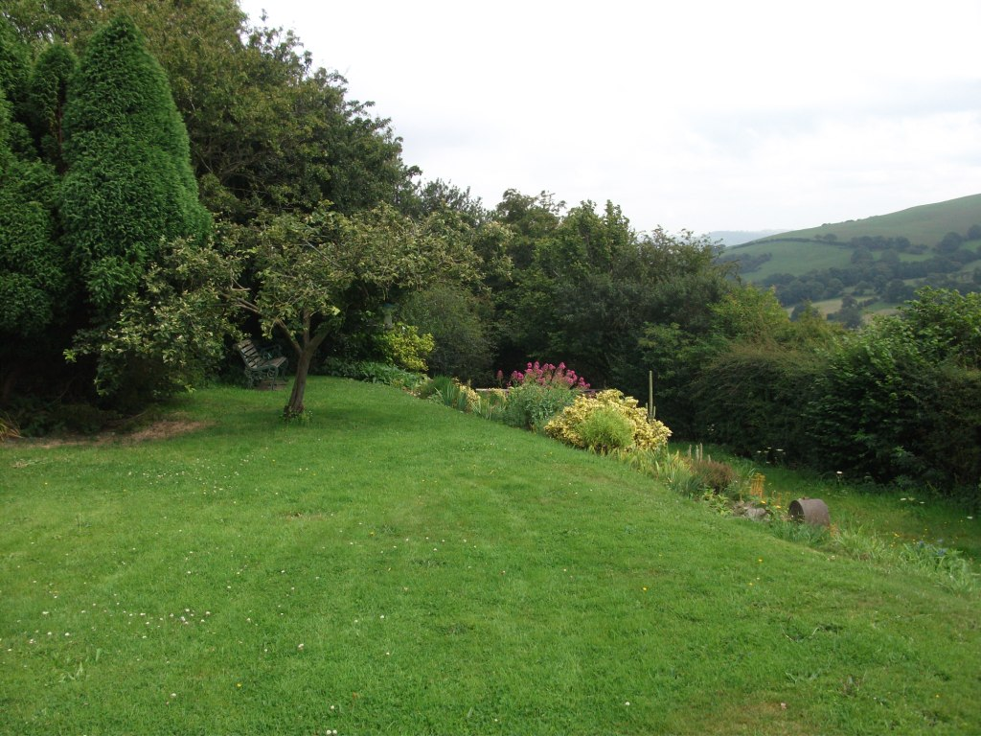

July = Temmuz

Slide 38
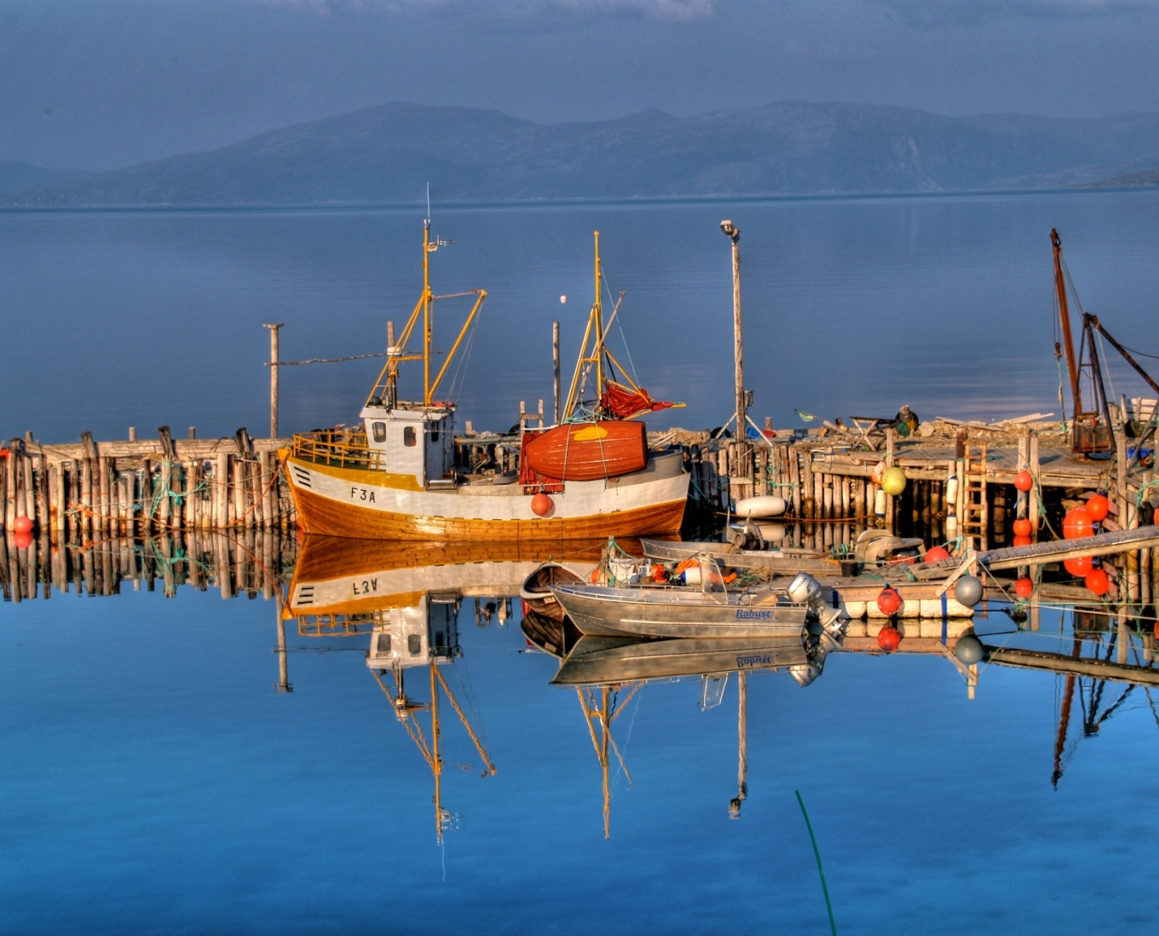
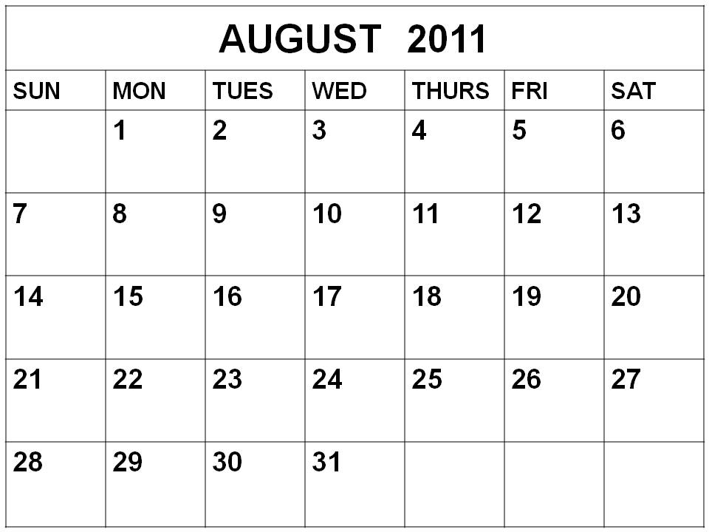
August = Ağustos

Slide 39


September = Eylül

Slide 40

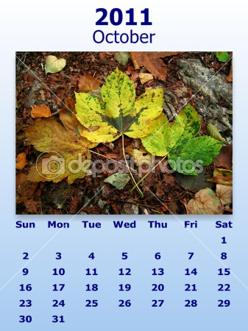
October = Ekim

Slide 41
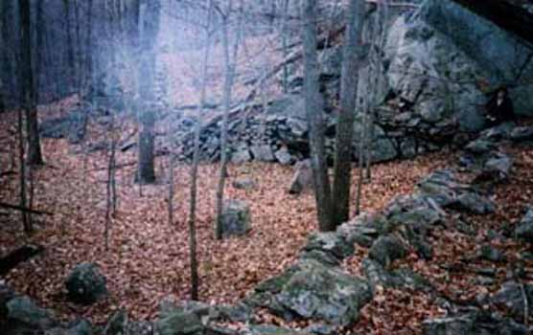
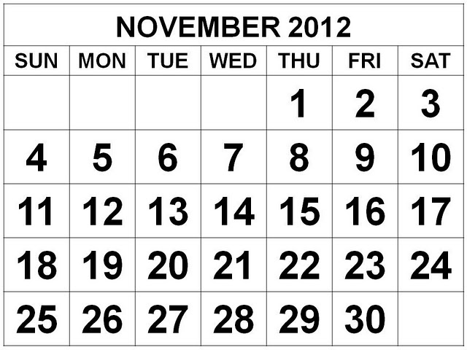
November = Kasım

Slide 42
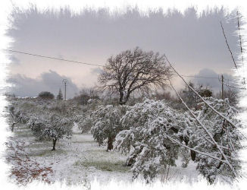
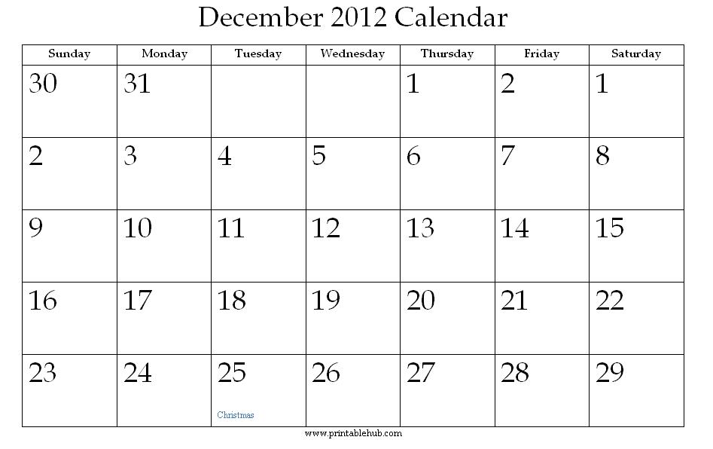
December = Aralık

Slide 43

Spring = İlkbahar

Slide 44

Summer = Yaz

Slide 45

Autumn/fall =Sonbahar

Slide 46
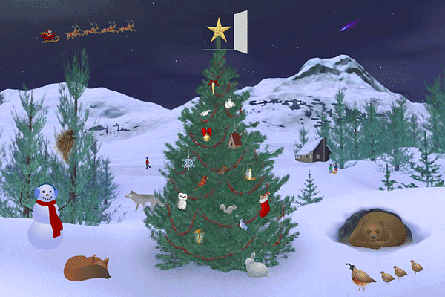
Winter =Kış

Slide 47
©
THIS IS NURCAN AKALTUN’S WORK
BU BİR NURCAN AKALTUN ÇALIŞMASIDIR.

