Slide 1
İNGİLİZCE PROJE
NAME:Emirhan
SURNAME:Atasever
CLASS:8/A
NUMBER:273
SUBJECT:Adventures

Slide 2
Talk about different sports and activities
Ask and answer questions about preferences
Describe and compare sports,activities and games
Understand personal narratives and brochures related to an adventures
Write a paragraph to compare two sports,activities or games

Slide 3
Write about their preferences and free time activities.
Clarify their questions whem needed.

Slide 4
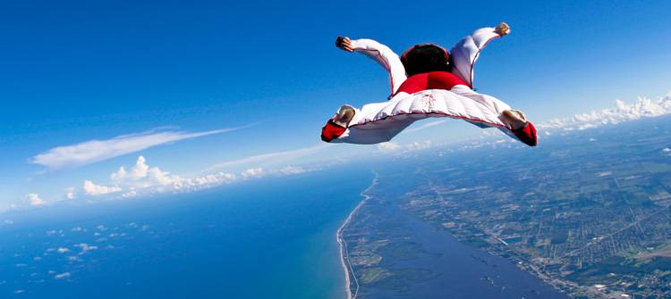
SKY DİVİNG:GÖKYÜZÜ DALIŞI

Slide 5
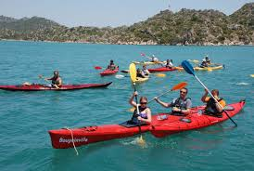
KAYAKİNG:KANODA GİTME

Slide 6
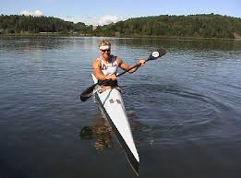
CANOEİNG:KANO GEZİNTİSİ YAPMAK

Slide 7
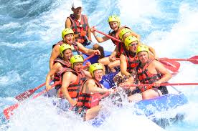
RAFTİNG:RAFTİNG YAPMA

Slide 8
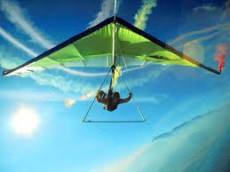
Hang Gliding:Delta kanat denen kanatlarla yapılan bir hava sporu

Slide 9
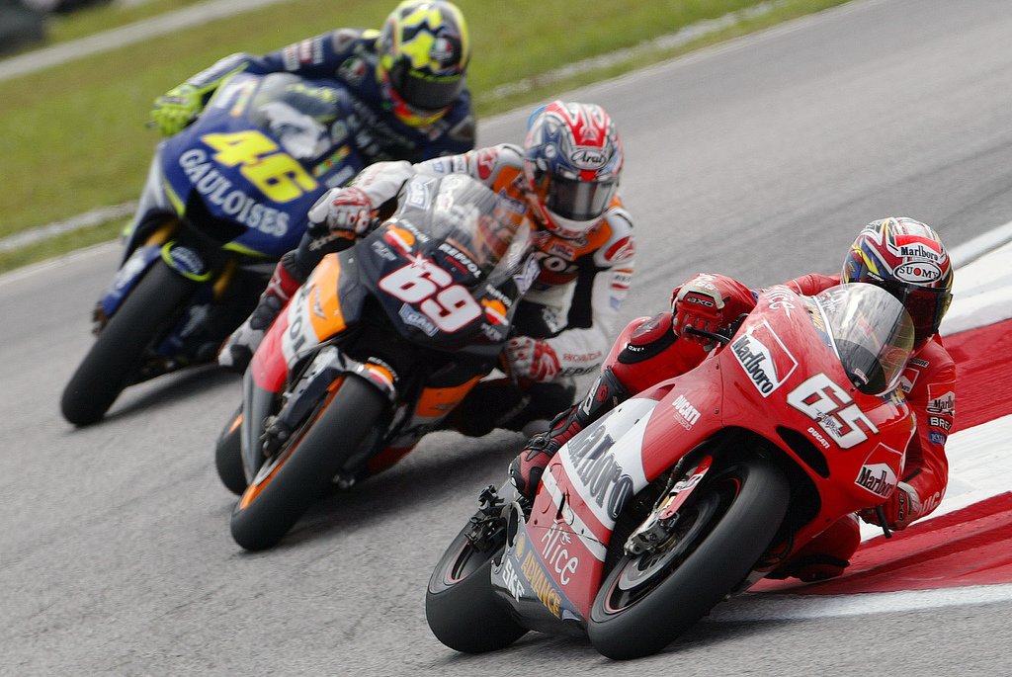
Motor Racing:Motorsiklet yarışı

Slide 10
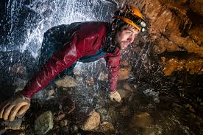
Caving:Mağaracılık sporu

Slide 11
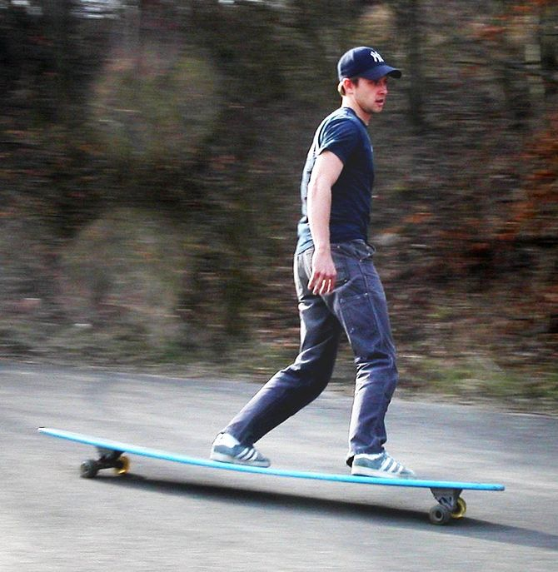
Skateboarding:Kaykay sporu

Slide 12
Challenging:Mücadeleci

Slide 13
Dangerous:Tehlikeli

Slide 14
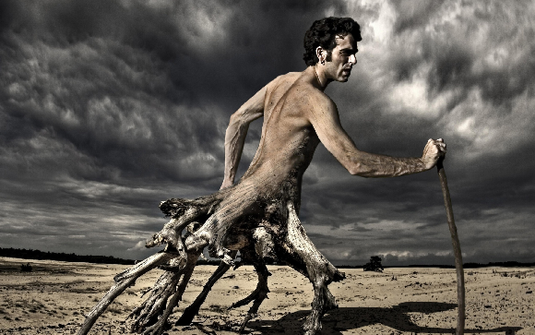
Fascinating:Büyüleyici

Slide 15
Entertaining:Eğlenceli

Slide 16
Easy:Kolay

Slide 17
Hard:Zor

Slide 18
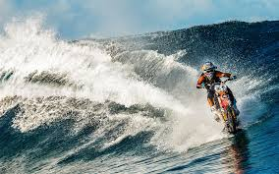
Extreme sports:Yüksek riski olan tehlikeli sporlar

Slide 19
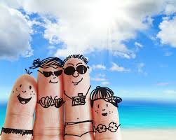
Vacation:Tatil

Slide 20
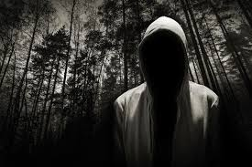
Mysterious:Gizemli

Slide 21
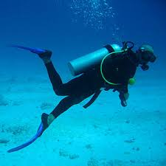
Scuba diving:Tüple dalış

Slide 22
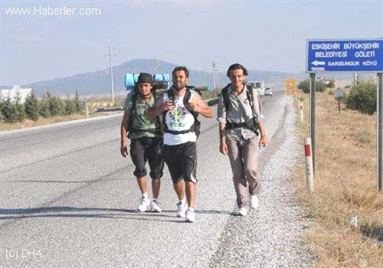
Trip:Gezi

Slide 23
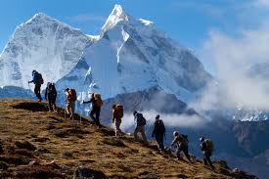
Trekking:Doğa yürüyüşü sporu

Slide 24
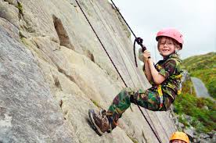
Rock climbing:Kaya tırmanışı

Slide 25
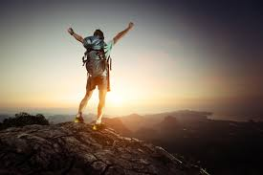
Adventure:Macera

Slide 26
Tiring:Yorucu

Slide 27
Boring:Sıkıcı

Slide 28
Heart-stopping:Nefes kesen

Slide 29
Safety:Güvenli

Slide 30
Protect:Koruma

Slide 31
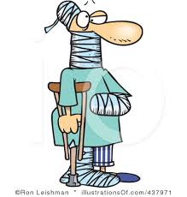
İnjured:Yaralı

Slide 32
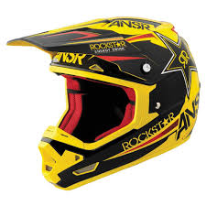
Helmet:Kask

Slide 33
First-aid:İlk yardım

Slide 34
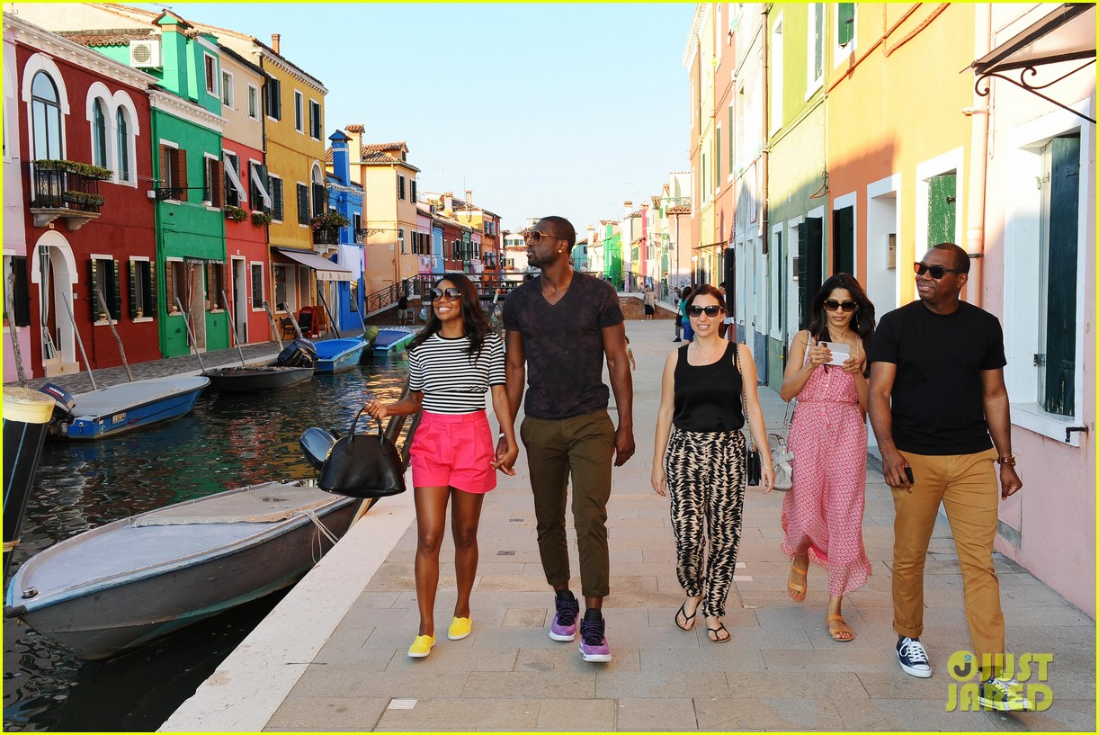
Sightseeing:Turistik yerleri gezip görme

Slide 35
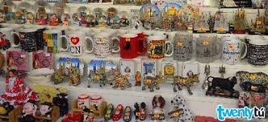
Souvenir:Hediyelik eşya

