Slide 1

ENGLISH
9th GRADE
MOVIES
PART B

Slide 2

Movies
9th Grade English
What are your hobbies?
Do you think you should try something different in your life?

Slide 3


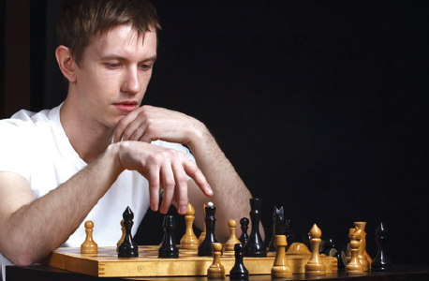
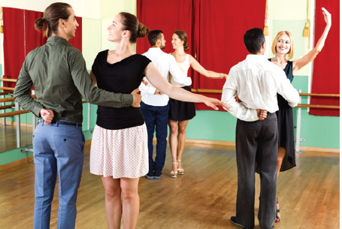
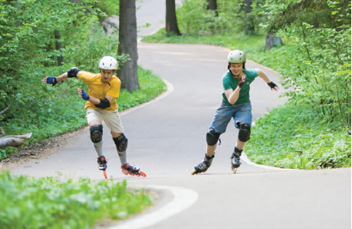
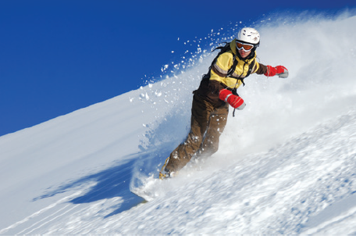

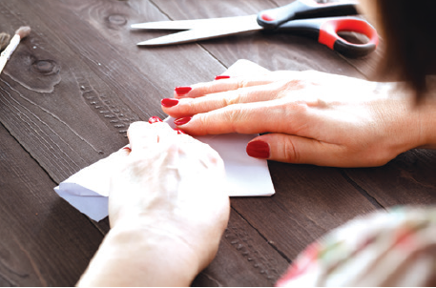
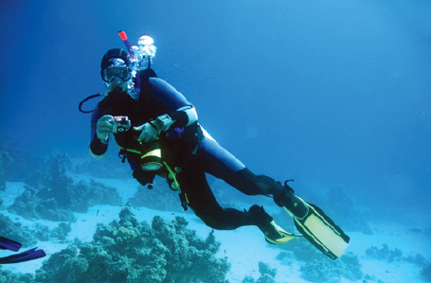
Movies
9th Grade English
Look at the photos. What free time activities are they?
playing chess
dancing
cycling
rollerblading
doing origami
scuba diving
taking photos
snowboarding
writing poems

Slide 4
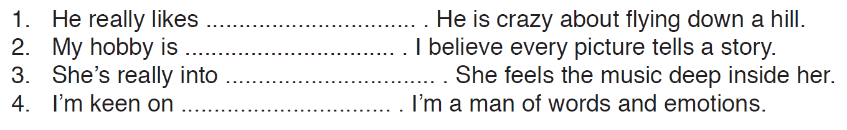
Movies
9th Grade English
Complete the sentences with the suitable free time activities.
snowboarding
taking photos
dancing
writing poems

Slide 5





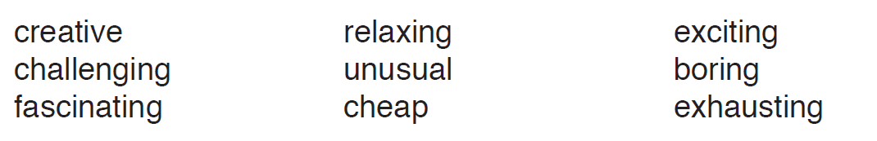

Movies
9th Grade English
9th Grade English
Listen to four people. Answer their questions giving your ideas about the activities.
I really like rollerblading. It is fascinating.
I quite like playing chess. It is challenging.
I don’t like writing poems. It is boring.
I hate dancing. It is exhausting.

Slide 6
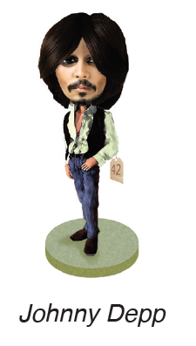



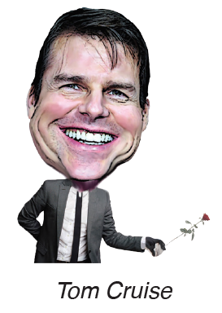
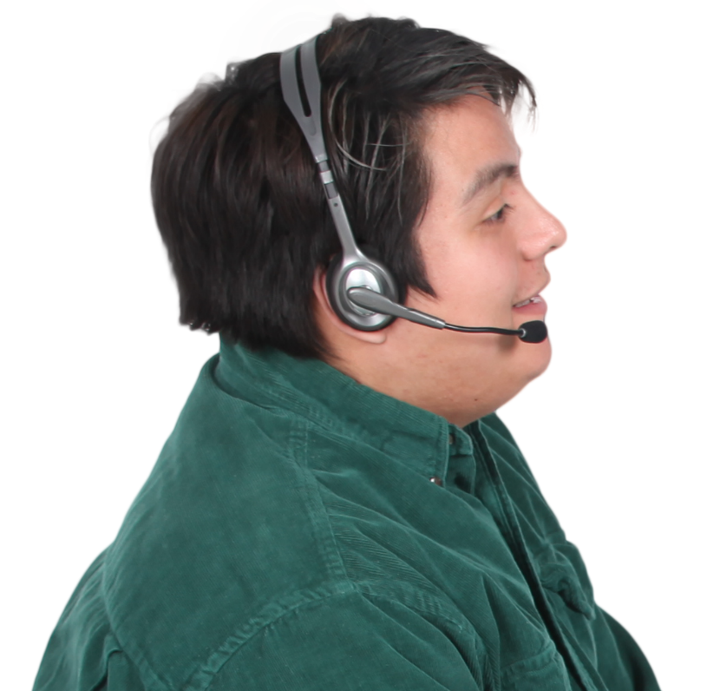

Movies
9th Grade English
Look at the caricatures and hobbies of the celebrities. Listen to the dialogue. Then give your ideas.
dancing / snowboarding / collecting dolls / knitting / collecting typewriters / fencing / writing poems
I think Tom Cruise likes dancing.
I think Tom Hanks likes writing poems.
I don’t agree with you. I think…..
I don’t agree with you. I think …..
I think Johnny Depp likes fencing.
I don’t agree with you. I think his hobby is collecting typewriters.
I don’t agree with you. I think…..
I don’t agree with you. I think …..
I think Cameron Diaz likes snowboarding.
I think Meryl Streep likes collecting dolls.

Slide 7
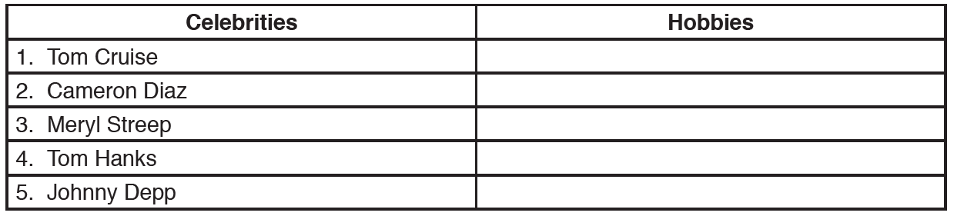
Movies
9th Grade English
Listen to DJ Chatty on a radio programme and find the celebrities’ real hobbies.
fencing
snowboarding
knitting
collecting typewriters
collecting dolls

Slide 8
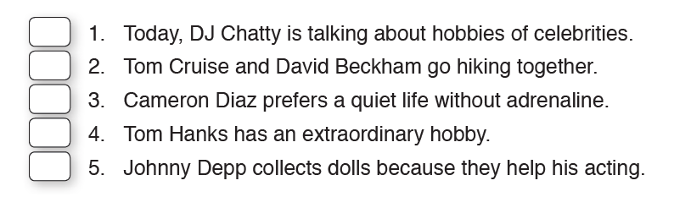
Movies
9th Grade English
Are these sentences TRUE OR FALSE?
T
F
F
T
T
2 They practice fencing together.
3 She loves the speed and adrenaline.

Slide 9
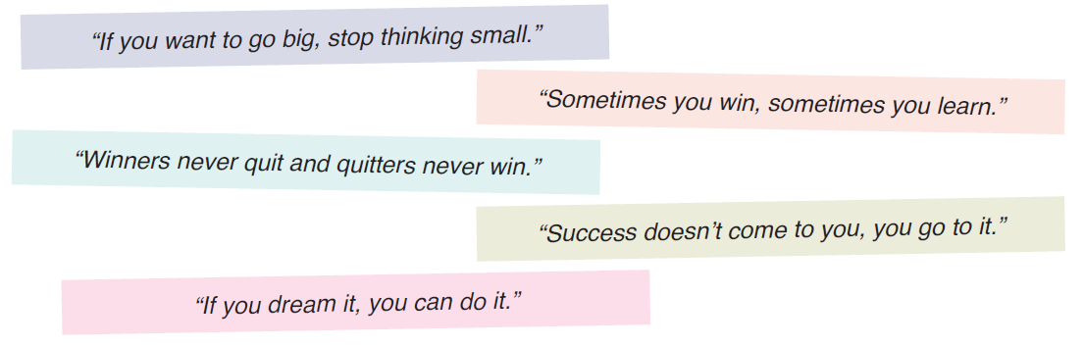
Movies
9th Grade English
Which quote is your favourite?

Slide 10
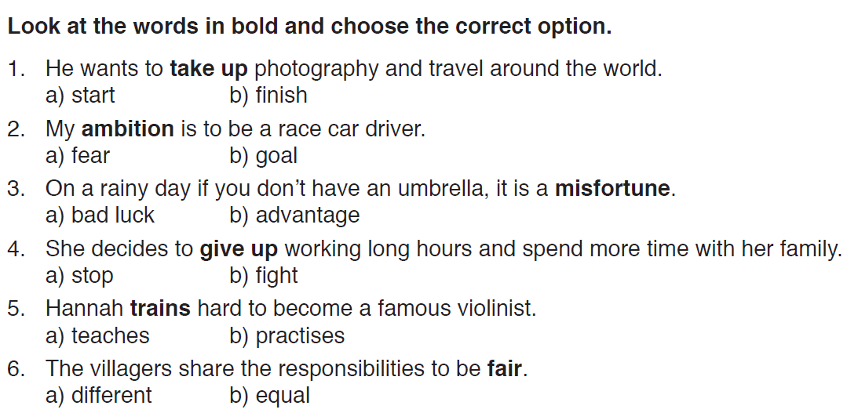
Movies
9th Grade English

Slide 11
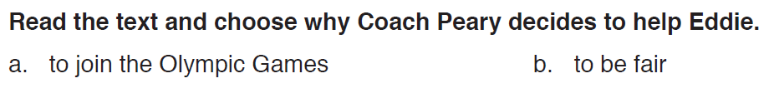

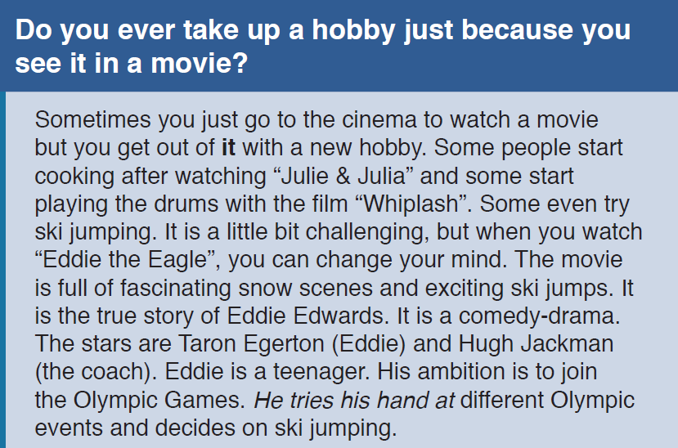
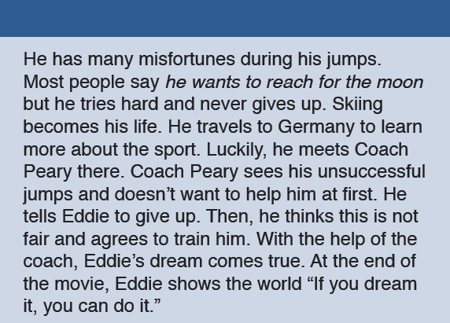
Movies
9th Grade English
What do you say to these sentences; YES or NO?
You can take up cooking when you watch ‘’Julie&Julia’’.
It’s a good idea for sports lovers to watch ‘’Whiplash’’.
YES
Coach Peary helps Eddie to reach his goal .
Eddie is an ambitious person and he never gives up.
YES
‘’Eddie the Eagle’’ has many beautiful scenes by the sea.
Eddie is good at ski jumping from the start.
NO
YES
NO
YES

Slide 12
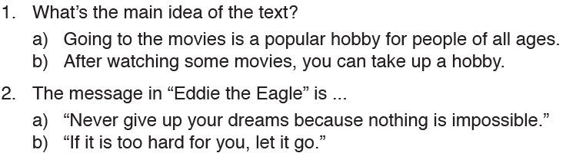
Movies
9th Grade English
Answer the questions about the text.

Slide 13
Movies
9th Grade English
3. Sometimes you just go to the cinema to watch a movie but you get out of with a new hobby. ‘it’ refers to …
it
a) the cinema
b) a hobby
4. What is Eddie’s dream?
a) to travel to different countries
b) to take part in Olympic events
5. He tries his hand at means …
a) He gets help from other people.
b) He starts doing something new or different.
6. He wants to reach for the moon means …
a) He has very high goals.
b) His ambition is to walk on the moon.

Slide 14

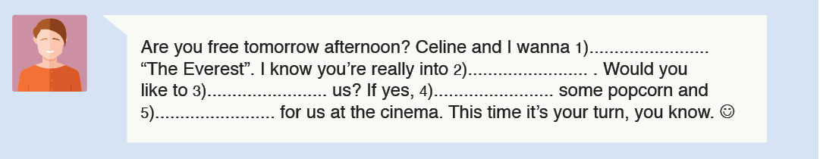
Movies
9th Grade English
wait
join
watch
grab
climbing

Slide 15

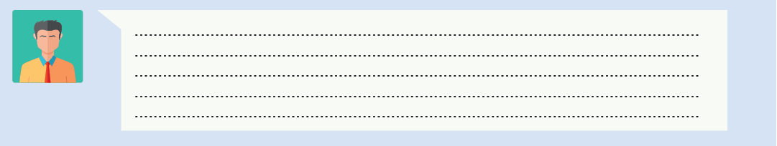
Movies
9th Grade English
In a nutshell…
Write a text message to invite your friend for a movie. Then send it to your English language teacher, please.

Slide 16
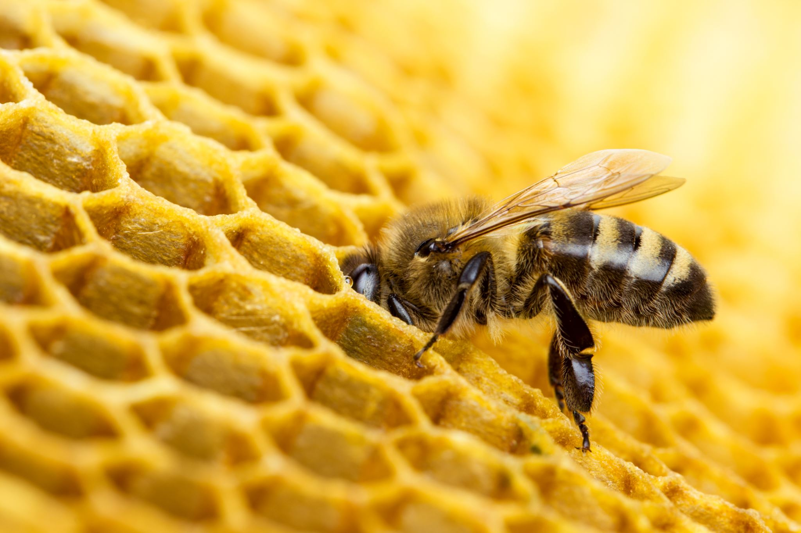
Movies
9th Grade English
You may ask your questions to your English language teacher at any time.

Slide 17
Movies
9th Grade English
Thanks for your participation.

