Slide 1


A. GOOD MORNING
B. GOOD EVENING

Slide 2

A. GOOD EVENING
B. GOOD MORNING

Slide 3

A. GOOD AFTERNOON
B. GOOD NIGHT

Slide 4

A. GOOD NIGHT
B. GOOD EVENING

Slide 5

A. HELLO
B. GOOD BYE

Slide 6

A. SEE YOU
B. WHAT IS YOUR NAME?

Slide 7
A. GOOD AFTERNOON
B. GOOD MORNING

Slide 8

A. NICE TO MEET YOU
B. MY NAME IS ERCAN

Slide 9

A. WHAT IS YOUR NAME?
B. HOW ARE YOU?

Slide 10
A. GOOD EVENING
B. GOOD AFTERNOON

Slide 11

A. GOOD BYE
B. HI

Slide 12

A.I AM FINE
B. I AM NOT OK

Slide 13
A. WHAT IS YOUR NAME?
B. HOW ARE YOU?

Slide 14

A.I AM FINE
B. I AM NOT OK

Slide 15

A. HOW ARE YOU?
B. WHAT IS YOUR NAME?

Slide 16
A. GOOD BYE
B. GOOD EVENING

Slide 17
A. GOOD EVENING
B. GOOD MORNING

Slide 18
A. HOW ARE YOU?
B. WHAT IS YOUR NAME?

Slide 19
A. I AM FINE
B. NICE TO MEET YOU

Slide 20
A. GOOD BYE
B. GOOD EVENING

Slide 21
A. HELLO
B. GOOD BYE

Slide 22
A.I AM FINE
B. GOOD BYE

Slide 23
A. HOW ARE YOU?
B. WHAT IS YOUR NAME?

Slide 24
A. GOOD AFTERNOON
B. GOOD NIGHT

Slide 25
A. I AM NOT GOOD
B. I AM NOT READY

Slide 26
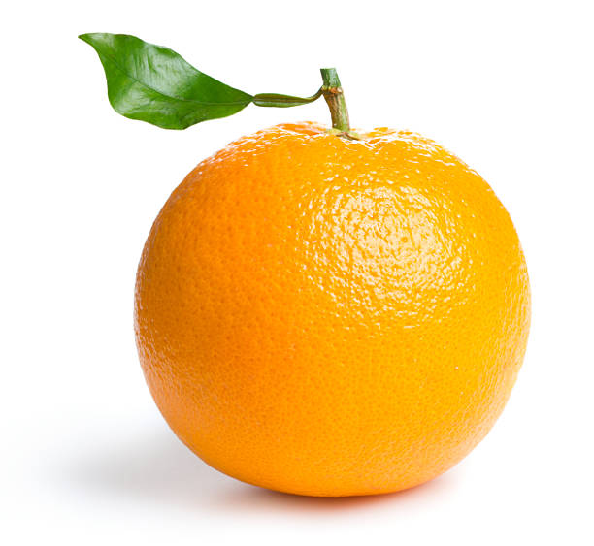
….. ORANGE
A. A
B. AN

Slide 27
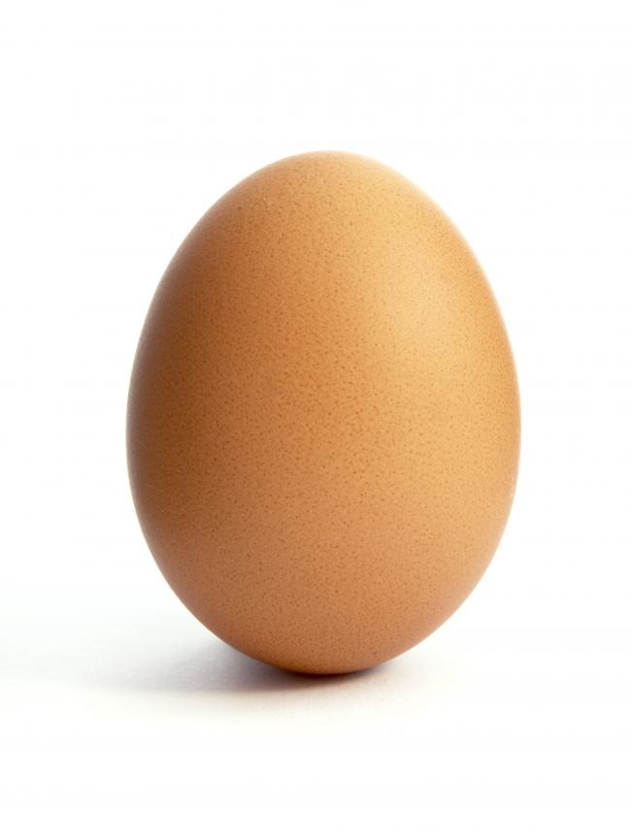
….. EGG
A. A
B. AN

Slide 28
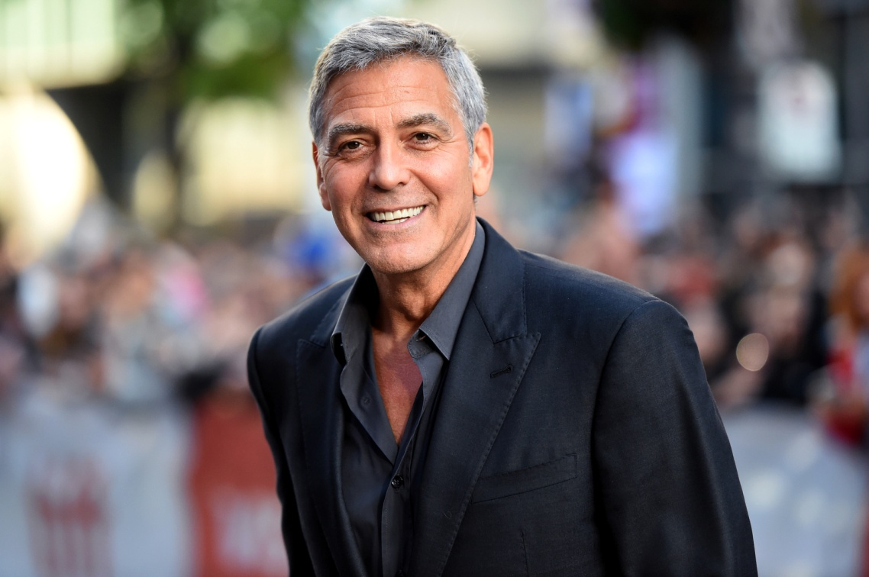
….. UNCLE
A. A
B. AN

Slide 29
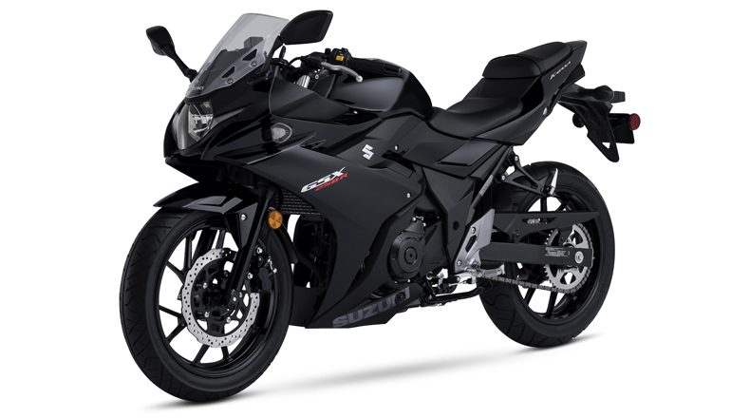
….. MOTORCYCLE
A. A
B. AN

Slide 30

….. ARM
A. A
B. AN

Slide 31
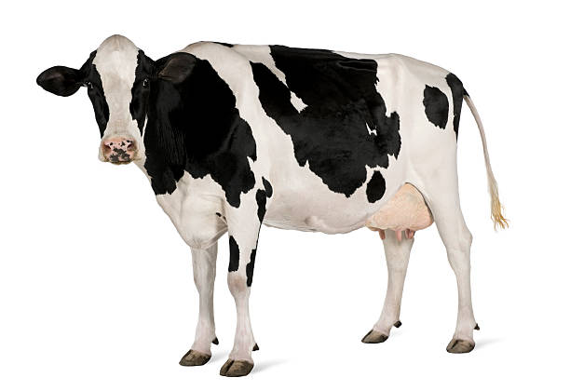
….. COW
A. A
B. AN

Slide 32
….. ORANGE
A. A
B. AN

Slide 33
….. EGG
A. A
B. AN

Slide 34
….. UNCLE
A. A
B. AN

Slide 35
….. MOTORCYCLE
A. A
B. AN

Slide 36
….. ARM
A. A
B. AN

Slide 37
….. COW
A. A
B. AN

Slide 38
A. GOOD MORNING
B. GOOD EVENING

Slide 39
A. GOOD AFTERNOON
B. GOOD NIGHT

Slide 40
A. GOOD EVENING
B. GOOD MORNING

Slide 41
A. GOOD NIGHT
B. GOOD EVENING

Slide 42
A. HELLO
B. GOOD BYE

Slide 43
A. SEE YOU
B. WHAT IS YOUR NAME?

Slide 44
A. GOOD AFTERNOON
B. GOOD MORNING

Slide 45
A. NICE TO MEET YOU
B. MY NAME IS ERCAN

Slide 46
A. WHAT IS YOUR NAME?
B. HOW ARE YOU?

Slide 47
A. GOOD EVENING
B. GOOD AFTERNOON

Slide 48
A. GOOD BYE
B. HI

Slide 49
A.I AM FINE
B. I AM NOT OK

Slide 50
A. WHAT IS YOUR NAME?
B. HOW ARE YOU?

