Slide 1
MY HOME

Slide 2
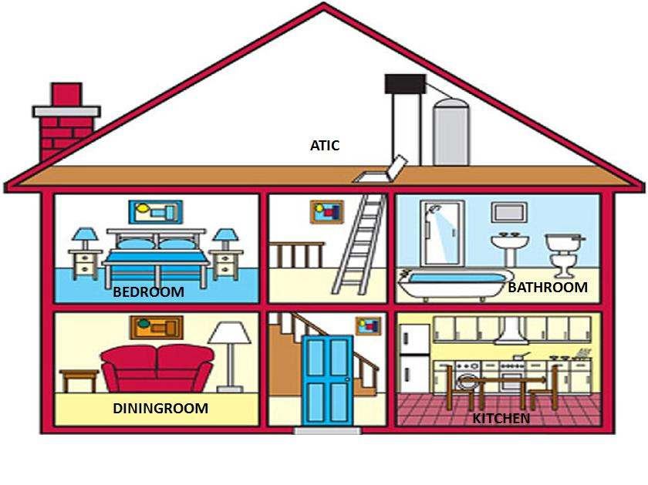

Slide 3
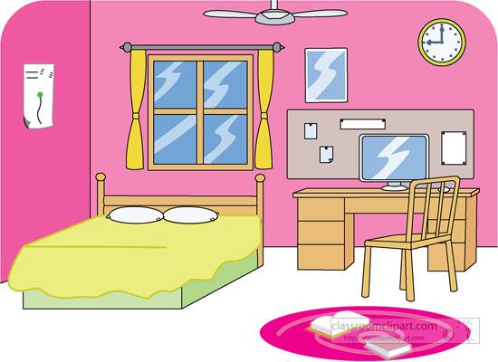
BEDROOM

Slide 4
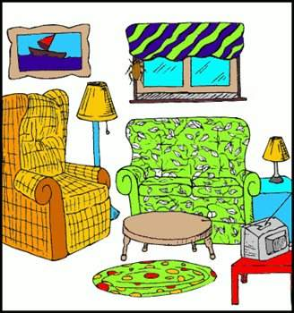
LIVINGROOM

Slide 5
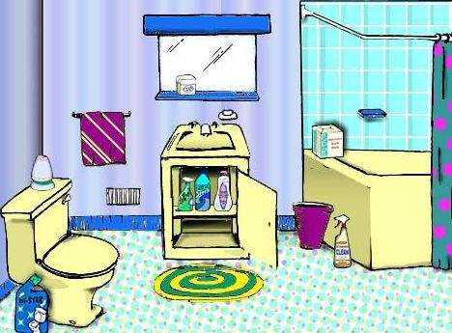
BATHROOM

Slide 6
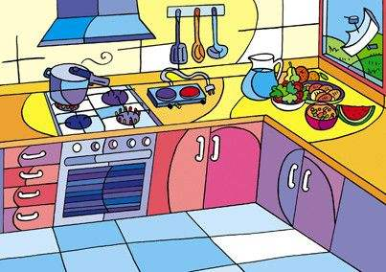
KITCHEN

Slide 7
GARAGE

Slide 8
GARDEN

