Slide 1
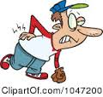
BACHACHE

Slide 2
BLANKET

Slide 3
BROKEN ARM

Slide 4
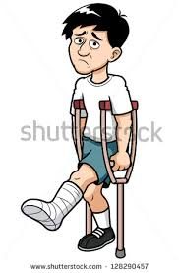
BROKEN LEG

Slide 5
CARRY HEAVY THİNGS

Slide 6
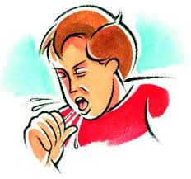
COUGH

Slide 7
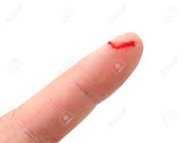
CUT

Slide 8
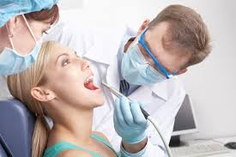
DENTİST

Slide 9
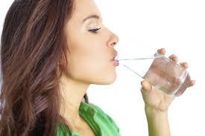
DRINK

Slide 10
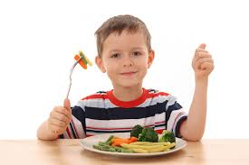
EAT

Slide 11
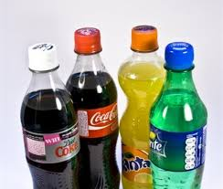
FIZZY DRINKS

Slide 12
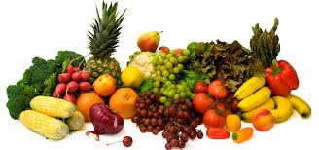
FRUIT AND VEGETABLES

Slide 13
FRUIT JUICE

Slide 14
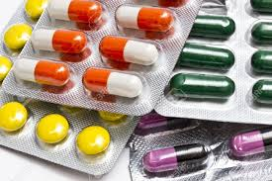
MEDICINE / PAINKILLER

Slide 15
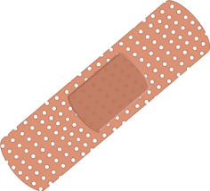
PLASTER / BANDAID

Slide 16
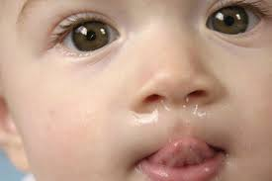
RUNNY NOSE

Slide 17
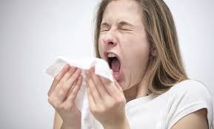
SNEEZE

Slide 18
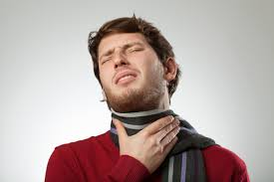
SORE THROAT

Slide 19
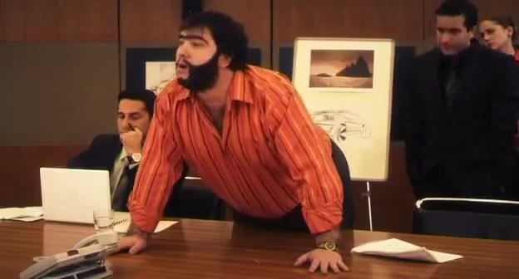
WHAT IS THE MATTER ? SORUN NE GARDAŞŞŞŞ

Slide 20
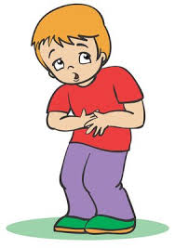
STOMACHACHE

Slide 21
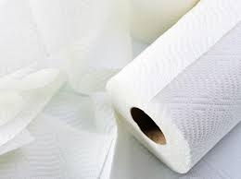
TISSUE

Slide 22
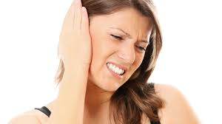
EARACHE

Slide 23
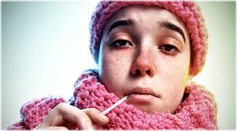
FLU

Slide 24
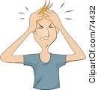
HEADACHE

Slide 25
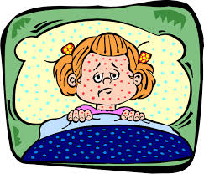
MEASLES

Slide 26
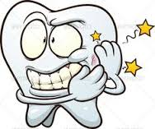
TOOTHACHE

