Slide 1
ADJECTIVES
big small tall short
fat ugly thin
beautiful clever stupid

Slide 2
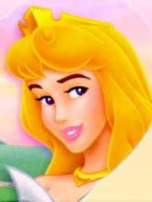
She is a beautiful princess.
beautiful

Slide 3
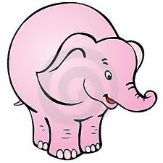
An elephant is a big animal.
big

Slide 4
Jerry is a clever mouse.
clever

Slide 5
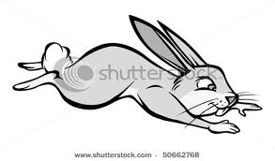
A rabbit is a fast animal.
fast

Slide 6
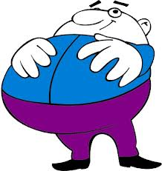
Mr. Etobur is a fat man.
fat

Slide 7
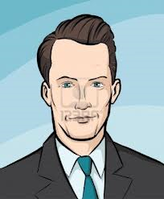
Mr. Karizma is a handsome man.
handsome

Slide 8
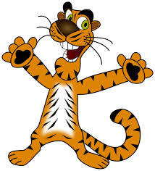
Max is a happy tiger.
happy

Slide 9
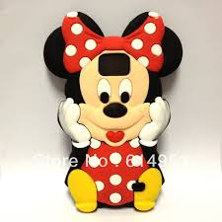
There is a lovely teddy bear.
lovely

Slide 10
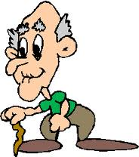
Mr. Tonton is an old person.
old

Slide 11
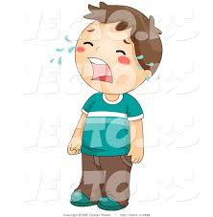
Metin is sad at that moment.
sad

Slide 12
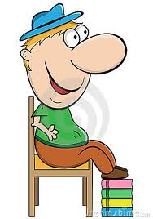
Güdük is a short boy.
short

Slide 13
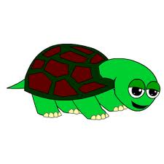
A turtle is a slow animal.
slow

Slide 14
There is a small fish in the aquarium.
small

Slide 15
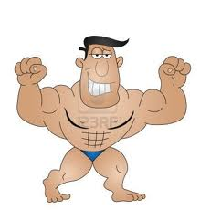
Mr. Kaslı is a strong man.
strong

Slide 16
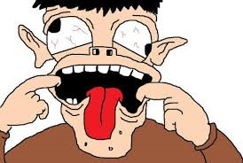
Şaşkın is a stupid boy.
stupid

Slide 17
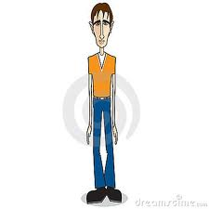
Mr. Sıska is a thin man.
thin

Slide 18
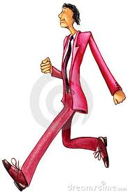
Mr. Sırık is a tall person.
tall

Slide 19
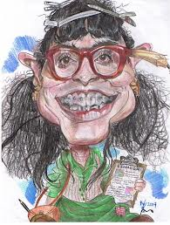
Mrs. Korkuluk is an ugly woman.
ugly

Slide 20
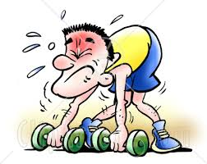
Mr. Cılız is a weak person.
weak

Slide 21
Rocky is a young boy.
young

