Slide 1
Task-Based Language Teaching
Dr. Yakup Çetin
Source: App. & Methods in Lang. Teaching
J.C. Richards & T.S. Rodgers

Slide 2
Task (n): a piece of work to be done or pefromed.
Task-Based Instruction Teaching (TBIT) is considered to be a development of CLT Method.
TBLT is an approach based on the use of tasks as the core unit of planning and instruction in L2 teaching.

Slide 3
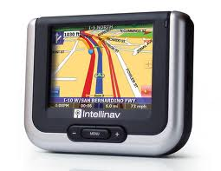
TBLT proposes the notion of "task" as a central unit of planning and teaching.
A task is an activity or goal that is carried out using language, such as finding a solution to a puzzle, reading a map and giving directions, making a telephone call, writing a letter, or reading a set of instructions and assembling a toy.
Eg. Give a task to the students: make them find a solution to poverty in Africa.

Slide 4
Tasks include:
Activities that involve real communication are essential for language learning.
Activities in which language is used for carrying out meaningful tasks promote learning.
Language that is meaningful to the learner supports the learning process.

Slide 5
The key assumptions of task-based instruction are summarized by Fee (1998: 17) as:
The focus is on process rather than product.
purposeful activities and tasks that emphasize communication and meaning.
Learners learn L2 by interacting communicatively and purposefully.
Activities and tasks are sequenced according to difficulty.
Activities and tasks can be either from real life or having pedagogical purpose.

Slide 6
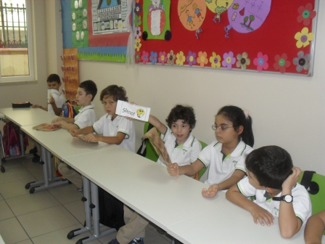
Theme: planning a picnic
Tasks
place
food
transport
games
music
Theme: application to a university
Tasks
applying to the university
corresponding with the department chair
inquiring about financial support
registering by phone
calculating and paying your fees

Slide 7
Tasks according to the type of interaction:
Jigsaw tasks:
These involve learners combining different pieces of information to form a whole (e.g., three individuals or groups may have three different parts of a story and have to piece the story together).

Slide 8
Information-gap tasks:
One student or group of students has one set of information and another student or group has a complementary set of information. They must negotiate and find out what the other party's information is in order to complete an activity.
Opinion exchange tasks:
Learners engage in discussion and exchange of ideas. They do not need to reach agreement.

Slide 9
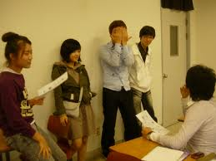
Problem-solving tasks:
Students are given a problem and a set of information. They must arrive at a solution to the problem. There is generally a single resolution of the outcome.
Decision-making tasks:
Students are given a problem for which there are a number of possible outcomes and they must choose one through negotiation and discussion.

Slide 10
Theory of language
TBLT emphasizes the central role of meaning in language use.
TBLT draws on structural, functional, and interactional models of language.
Vocabulary plays a more central role in TBLT which include lexical phrases, sentence stems, prefabricated routines, and collocations, and so on.
The majority of tasks within TBLT involve communication and conversation.

Slide 11
Theory of learning
TBLT provides full opportunities for both input and output requirements for L2 successful learning.
Tasks foster processes of negotiation, modification, rephrasing, and experimentation with language that are at the heart of L2 learning.
Tasks can be designed to facilitate the use and learning of particular aspects of language such as discourse, accuracy, complexity, or fluency.

Slide 12
Tasks improve learner motivation and therefore promote learning.
They typically include physical activity, they involve partnership and collaboration, they may call on the learner's past experience, and they tolerate and encourage a variety of communication styles.

Slide 13
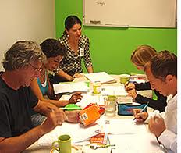
Many tasks will be done in pairs or small groups.
Class activities are designed so that students have the opportunity to notice how language is used in communication.
Many tasks will require learners to create and interpret messages for which they lack full linguistic resources and experience.

Slide 14
Teacher roles
selector and sequencer of tasks
preparing learners for tasks
consciousness-raising
The role of instructional materials
pedagogic materials
realia (newspapers, television, internet, etc.)

