Slide 1
The Audio-Lingual Method
HUM 403 Methodology in ELT
Dr. Yakup Cetin

Slide 2
INTRODUCTION
In World War II, the US needed personnel to
learn foreign languages very quickly as part of
their military operations in Germany, Russia, France, Vietnam.
The "Army Method“ (former name of Audio-lingual Method) was developed to provide agents, interpreters, translators, informants with communicative fluency.
Correct pronunciation, stress, rhythm, and intonation are emphasized.
Native communication skills were achieved through very intensive language courses that focus on aural/oral skills.
Officers studied 10 hours a day, 6 days a week. There were generally 15 hours of drill with native speakers and 20 to 30 hours of private study spread over two to three 6-week sessions.

Slide 3
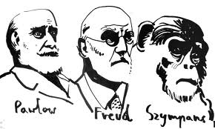
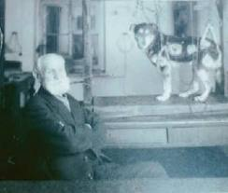
ALM has a strong theoretical base in linguistics (structure) and psychology (behaviorism) (Skinner, Thorndike, Paulov).
Behaviorism and structural linguistics are anti-mentalist, empirically (experimental) based approach to the study of human behavior. They depend on three important elements: stimulus, response, and reinforcement.
ALM aims habit formation through mechanical drills.

Slide 4
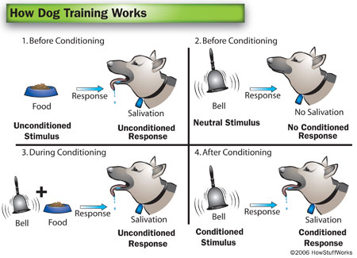

Slide 5
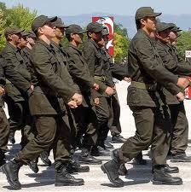
ALM is mainly based on memorizing dialogues through highly controlled practice including imitation, drills and repetitions.
Dialogues provides the context for key structures and situations in which structures might be used as well as some cultural aspects of the target language.
E.g. A group of soldiers doing marching drills in the exercise yard, listening to the short commands and repeating them until they are memorized. (Add Video Ay akşamdan ışıktır, yaylalar yaylalar ...)

Slide 6
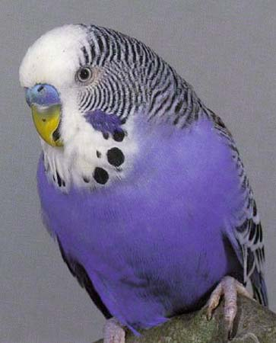
ALM focuses mainly on drills to teach grammatical sentence patterns through tapes, language labs, and visual aids.
E.g. Language learning is like learning driving a car.
Examples To drills
T: I bought the ticket. > She.
SS: She bought the ticket.
T: They.
SS: They bought the ticket.
T: We.
SS: We bought the ticket.
T: We are going to the cinema. > Zoo.
SS: We are going to the zoo.
T: Restaurant.
SS: We are going to the restaurant.
T: Concert.
SS: We are going to the concert.

Slide 7
Energizer

Slide 8
.
For Charles Fries (1945) , grammar, or "structure," was the starting point to teach language.
Language skills are learned more effectively if the items to be learned
in the target language are presented in spoken form before they are
seen in written form. Thus, reading and writing skills come later.
Therefore, the idea in ALM is that practice makes perfect.
E.g. Sentence Patterns
bill : Good morning, Sally.
Sally: How are you?
Bill: Fine, thanks. And you?
Sally: Fine. Where are you going?
bill: I'm going to the post office.
Sally: I am too. Shall we go together?
bill : Sure. Let's go.

Slide 9
SAMPLE VIDEO TEACHING

Slide 10
THINKING ABOUT THE EXPERIENCE
1 The teacher introduces a new dialog.
2 The language teacher uses only the target language in the classroom. Actions, pictures, or realia are used to make the meaning clear.
Language forms/structures occur most naturally within a context.
The native language and the target language have separate linguistic systems. They should be kept apart so that the students' native language interferes as little as possible with the target language.

Slide 11
3 The language teacher introduces the dialog by modeling it several times. He corrects mispronunciation by modeling the proper sounds in the target language
4 The students repeat each line of the new dialog several times.
5 The students stumble over one of the lines of the dialog. The teacher uses a backward build­up drill with this line.
One of the language teacher's major roles is that of a model of the target language. By listening to how it is supposed to sound, students should be able to mimic the model.
Language learning is a process of habit formation. The more often something is repeated, the stronger the habit and the greater the learning.
It is important to prevent learners from making errors. Errors lead to the formation of bad habits.

Slide 12
6 The teacher initiates a chain drill, single-slot and multiple-slot substitution drills in which students interact with each other.
8 The teacher says, 'Very good,' when the students answer correctly.
The purpose of language learning is to learn how to use the language to communicate through different forms of drills.
Positive reinforcement (motivation, reward) helps the students to develop correct habits.

Slide 13
Energizer

Slide 14
9 The teacher uses spoken cues and picture cues.
10 The teacher conducts
transformation and question-and-answer drills.
11 When the students can handle it, the teacher poses the questions to them rapidly.
Students should learn to respond to both verbal and nonverbal stimuli.
Each language has a finite number of patterns. Pattern practice helps students to form habits which enable the students to use the patterns.
Students should 'overlearn,' i.e. learn to answer automatically without stopping to think.

Slide 15
12 The teacher provides the students with cues; she calls on individuals; she smiles encouragement; she holds up pictures one after another.
13 New vocabulary is introduced through lines of the dialog; vocabulary is limited.
14 Students are given no grammar rules; grammatical points are taught through examples and drills.
The teacher should be like an orchestra leader —conducting, guiding, and controlling the students' learning.
The major objective of language teaching should be for students to acquire the structural patterns; rather than vocabulary.
The rules necessary to use the target language will be figured out or induced (inductive grammar teaching) from examples.

Slide 16
15 The teacher does a contrastive analysis of the target language and the students' native language in order to overcome mistakes.
16 The teacher writes the dialog on the blackboard toward the end of the week. The students do some limited written work with the dialog and the sentence drills.
A comparison between the native and target language will tell the teacher in what areas her students will probably experience difficulty.
Speech is more basic to language than the written form - skill acquisition is like: listening, speaking, reading, and writing.

Slide 17
Energizer

Slide 18
REVIEWING THE PRINCIPLES
1 What are the goals of teachers who use the Audio-Lingual Method?
Students are required to use the target language communicatively. Therefore, teachers believe students need to memorize the target language, to learn to use it automatically without stopping to think. Their students achieve this by forming new habits in the L2 and overcoming the old habits of their L2.
2 What is the role of the teacher? What is the role of the students?
The teacher is like an orchestra leader, directing and controlling the language of the students. The teacher is also responsible for providing her students with a good model for imitation.
Students are imitators of the teacher's model or the tapes of native speakers. They follow the teacher's directions and respond as accurately and as rapidly as possible.

Slide 19
3 What are some characteristics of the teaching/learning process?
New vocabulary and structural patterns are presented through dialogs. The dialogs are learned through imitation and repetition of drills.
Drills (such as repetition, backward build-up, chain, substitution, transformation, and question-and-answer) are conducted based upon the patterns present in the dialog.
Students' successful responses are positively reinforced.
Grammar is induced from the examples given; explicit grammar rules are not provided.
Cultural information is contextualized in the dialogs or presented by the teacher.
Students reading and written work is based upon the oral work they did earlier.

Slide 20
4 What is the nature of student-teacher interaction? What is the nature of student-student interaction?
Most of the interaction is between teacher and students and is initiated by the teacher.
5 How are the feelings of the students dealt with?
There are no principles of the method that relate to this area.
6 How is the language viewed? How is the culture viewed?
Everyday speech is emphasized in the Audio-Lingual Method. The level of complexity of the speech is graded, however, so that beginning students are presented with only simple patterns.
Culture consists of the everyday behavior and lifestyle of the target language speakers‘.

Slide 21
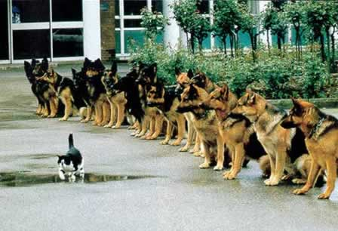
Energizer

Slide 22
7 What areas of language are emphasized? What language skills are emphasized?
The natural order of skills presentation is : listening, speaking, reading, and writing. The oral/aural skills receive most of the attention. What students write they have first been introduced orally. Pronunciation is taught from the beginning, often by student working in language laboratories.
8 What is the role of the students' native language?
The habits of the students' native language are thought to interfere such as word order in L1 and L2. Therefore, the target language is used in the classroom, not the students' native language.
A contrastive analysis between the students' native language and the target language will tell the teacher what mistakes may occur.

Slide 23
9 How is evaluation accomplished?
The answer to this question is not obvious because we did not actually observe the students in this class taking a formal test.
10 How does the teacher respond to student errors?
Student errors are to be avoided if at all possible through the teacher's use of different forms of drills.

Slide 24
Check your understanding of the Audio-Lingual Method.
1 Which of the following techniques follows from the principles of the Audio-Lingual Method, and which ones don't? Explain the reasons for your answer.
a The teacher asks beginning-level students to write a composition about the system of transportation in their home countries. If the need a vocabulary word that they don't know, they are told to look in a bilingual dictionary for a translation.
b Toward the end of the third week of the course, the teacher gives students a reading passage. The teacher asks the students to read the passage and to answer certain questions based upon it. The passage contains words and structures introduced during the first three weeks of the course.
c The teacher tells the students that they must add an's' to third per son singular verbs in the present tense in English. She then gives the students a list of verbs and asks them to change the verbs into the third person singular present tense form.

